Slide 1
Git Basic
The Tran

Slide 2
The past: CVS and SVN
Centralized Version Control Systems
Key concepts:
Users check code into central server
Require connection to the server to perform commits, create branch, merge, view history,…

Slide 3
What is Git?
Distributed Version Control System
Directory content management system
Tree history storage system
Created by Linus Torvald in 2005

Slide 4
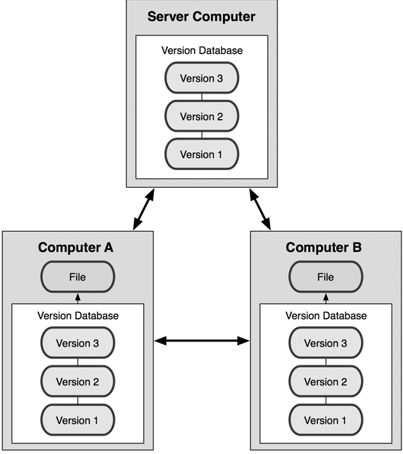
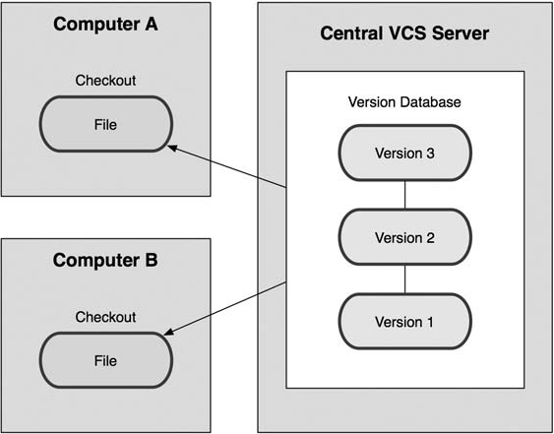
Git vs SVN
Git: Distributed repository
SVN: Centralized repository

Slide 5
Git Basic
Distributed repository
Full history of commits
You can commit, create branch, merge locally (nearly every operation is local)
Notes:
For example, to browse the history of the project, Git doesn’t need to go out to the server to
get the history and display it for you—it simply reads it directly from your local database.
If you want to see the changes introduced between the current version of a file and the file a month ago, Git can look up the file from
a month ago and do a local difference calculation, instead of having to either ask a remote server
to do it or pull an older version of the file from the remote server to do it locally.

Slide 6
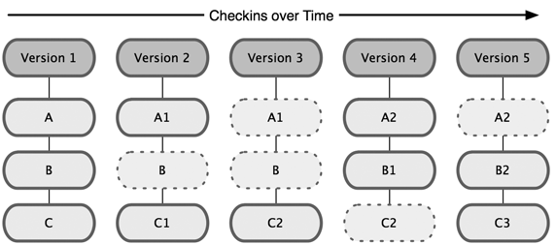
Git Basic: Snapshot
Git thinks of its data more like a set of snapshots of a mini filesytem
Every time you commit, Git create a snapshot for changes in project

Slide 7
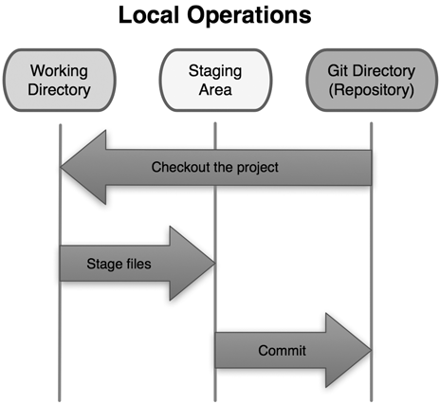
Git Basic: 3 States
Modified, staged and committed

Slide 8
Basic Usage
Clone code from remote repository (BitBucket, GitHub…)
$ git clone <repository-url>

Slide 9
Basic Workflow
unstaged
git add <files>
staged
local repo
remote repo
git commit
git push

Slide 10
Basic Usage
Checking the status of your files
$ git status
Tracking new file
$ git add <file>
Staging modified file
$ git add <file>

Slide 11
Basic Usage
View what you have changed
Staged files: git diff –-cached
Unstaged files: git diff
Commit your changes
git commit
git commit –m “your commit message here”

Slide 12
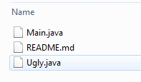

Basic Usage
RECOMMENDED
Remove files from Git repository
git rm Ugly.java
git rm –-cached Ugly.java

Slide 13
Basic Usage
View the commit history
$ git log
$ gitk (UI tool)

Slide 14
Undo Things
Changing your last commit
When you commit too early and possibly forget to add some files, or you mess up your commit message
$ git commit –-amend

Slide 15
Undo Things
Unstaging a staged file
You’ve changed two files and want to commit them as two separate changes, but you accidentally type git add * and stage them both.
$ git reset HEAD <file>

Slide 16
Undo Things
Unmodifying a modified file
What if you realize that you don’t want to keep your changes to the file?
$ git checkout -- <file>

Slide 17
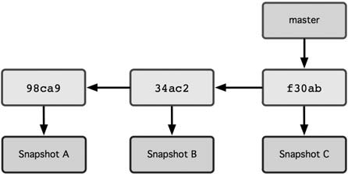
Working with Branches
Branch pointing into the commit data’s history

Slide 18
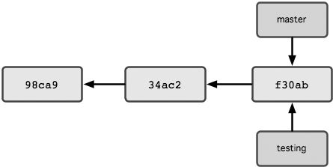
Working with Branches
Create branch testing from branch master:
$ git checkout master
$ git checkout –b testing

Slide 19
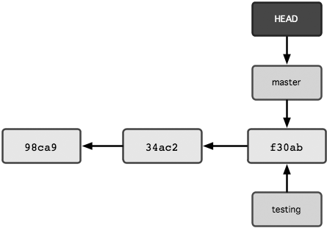
Working with Branches
How does Git know what branch you’re currently on?
HEAD pointer

Slide 20
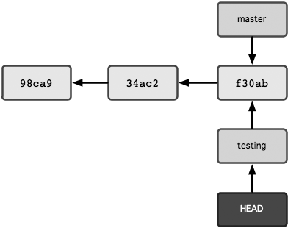
Working with Branches
Switch to branch testing
$ git checkout testing

Slide 21
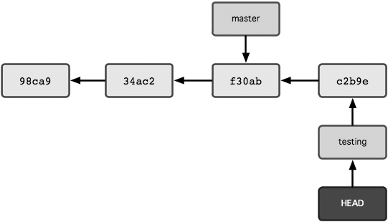
Working with Branches
Commit some changes on branch testing

Slide 22
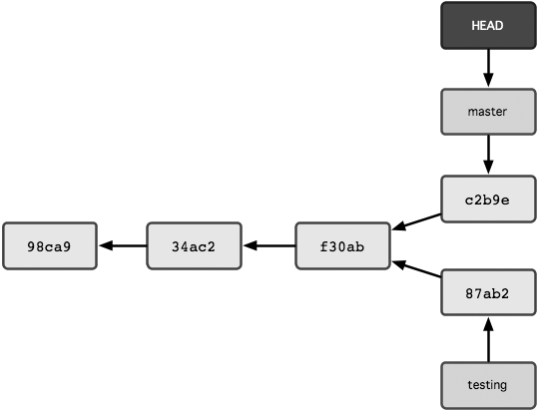
Working with Branches
Switch back to branch master, make some changes, and commit them

Slide 23
Working with Branches
What happened when switching to a branch?
Git changes the current branch to the branch you check out (remember HEAD pointer)
Git resets your working directory to look like the snapshot of the commit that the branch you check out points to
LEARN BY HEART!

Slide 24
Working with Branches
Before switching to other branch
Note that if your working directory or staging area has uncommitted changes that conflict with the branch you’re checking out, Git won’t let you switch branches.
It’s best to have a clean working state when you switch branches

Slide 25
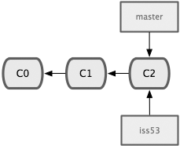
Branch Merging
Create new branch from branch master to work on new issue
$ git checkout master
$ git pull origin master
$ git checkout –b iss53

Slide 26
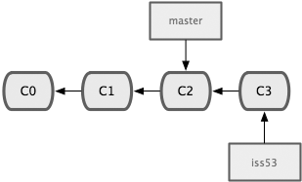
Branch Merging
Make some changes and do commit on branch iss53
$ vim index.html
$ git add index.html
$ git commit –m “iss53# added a new footer”

Slide 27
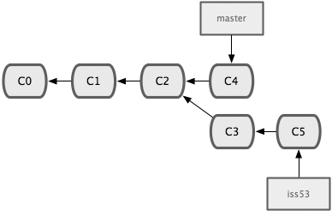
Branch Merging
Switch back to branch master, make some changes and do commit
Switch back to branch iss53, make some changes and do commit

Slide 28
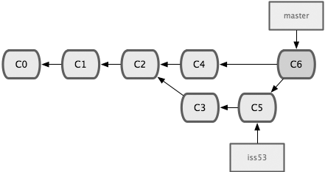
Branch Merging
Suppose you’ve decided that your issue #53 work is complete and ready to be merged into your master branch
$ git checkout master
$ git merge iss53

Slide 29
Dealing with Merge Conflicts
You changed the same part of the same file differently in the two branches you’re merging together
View which files are unmerged
$ git status
Developers must resolve conflict using merge tools or text editor. Then use git add <file> to add these merged files to staging state.
If you use merge tool, Git may run git add automatically for you.
When all conflicts are resolved, you can run git commit to finalize the merge commit.

Slide 30
Merge Using BitBucket Pull Request
Use BitBucket Pull Request to merge branch iss53 into branch master

Slide 31
Merge Using BitBucket Pull Request
Push our local branch iss53 to BitBucket repository
$ git push –u origin iss53
=> Local branch iss53 set up to track remote branch iss53 from origin
Tip:
Using $ git remote –v to view your remotes
git@bitbucket.org:thetran/test.git

Slide 32
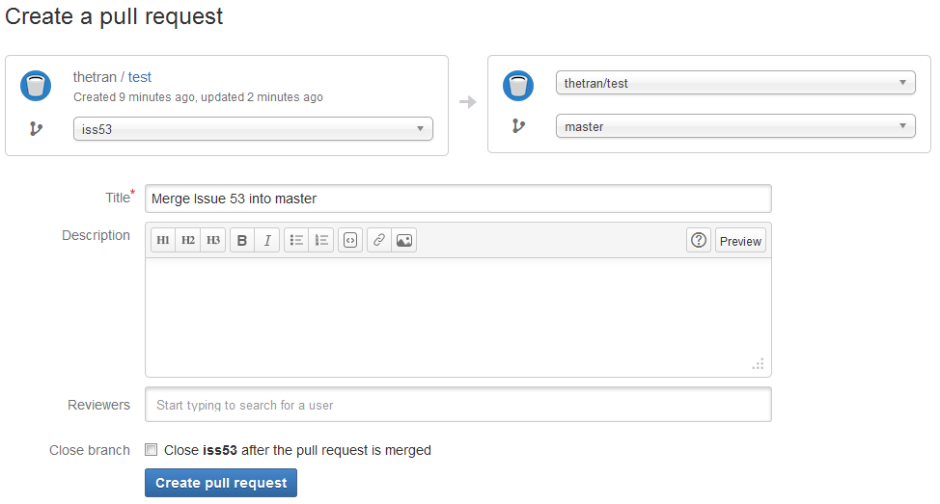
Merge Using BitBucket Pull Request

Slide 33
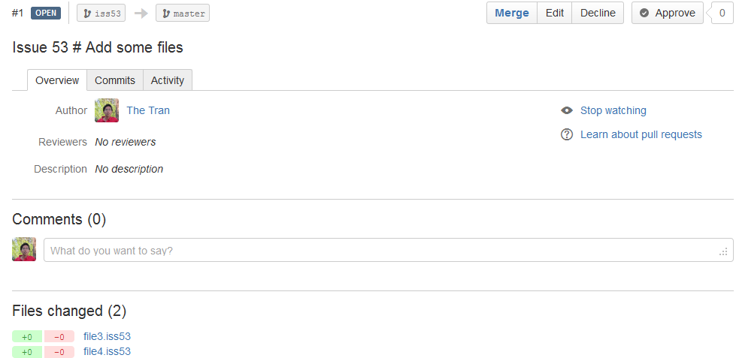
Merge Using BitBucket Pull Request

Slide 34
Working with Remotes
Show your remotes
$ git remote –v
Add remote repository
$ git remote add <repo_alias> remote_repo_url
Remove remote repository
$ git remote rm <repo_alias>
If you cloned a repository, the command automatically adds that remote repository under the name origin.

Slide 35
Working with Remotes
fetch and pull from your remote
$ git fetch origin : fetches any new work that has been pushed to that server since you cloned (or last fetched from) it
If you have a branch set up to track a remote branch, you can use the pull command to automatically fetch and then merge a remote branch into your current branch.

Slide 36
Working with Remotes
Push your local branch to the remote repository
$ git push –u origin iss53
Your local branch iss53 now track remote branch origin/iss53
Create local branch to track existing remote branch iss54
$ git fetch origin
$ git checkout –b iss54 origin/iss54
Push your work to remote repository
$ git checkout iss53
$ git pull origin iss53
$ git push origin iss53

Slide 37
Apply to GBST FO
$ git clone <repository-url>
Update your repository
$ git fetch origin
Get latest code from branch master
$ git checkout master
$ git pull origin master
Create your own local branch from master
$ git checkout –b iss55
Push your local branch to remote repository
$ git push –u origin iss55
Coding your feature, commit your work to your local repository
$ git commit
Push your work from local repository to remote repository
$ git pull origin iss55
$ git push origin iss55

Slide 38
Q & A

